Slide 1






Bootcamp
Daily Meetings
Basic Level
Carolina Gomez M.
May 28th, 2024

Slide 2
Table of content
1
Review
2
Daily Meetings
3
Useful phrases

Slide 3
What did we do last class?
Virtual Calls
Phone Vocabulary
Online Meetings
https://create.kahoot.it/details/deac8f51-0258-4236-b211-d2883c586d72

Slide 4


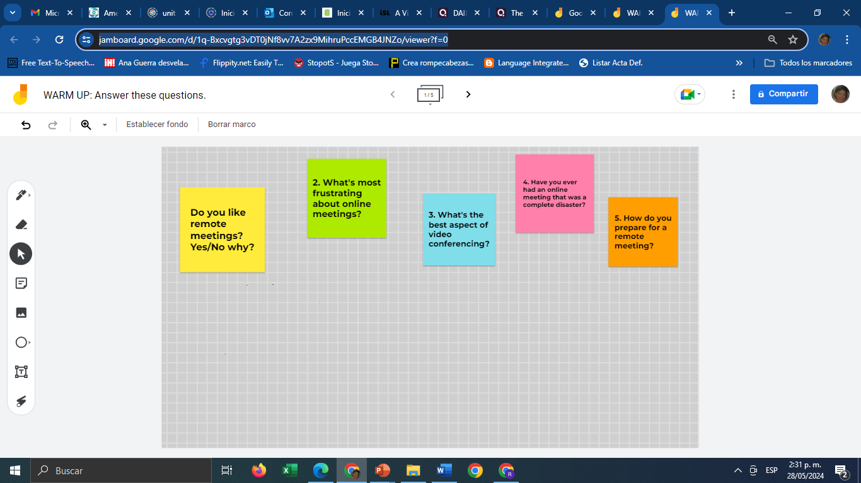
Warm Up
https://jamboard.google.com/d/1q-Bxcvgtg3vDT0jNf8vv7A2zx9MihruPccEMGB4JNZo/viewer?f=0

Slide 5


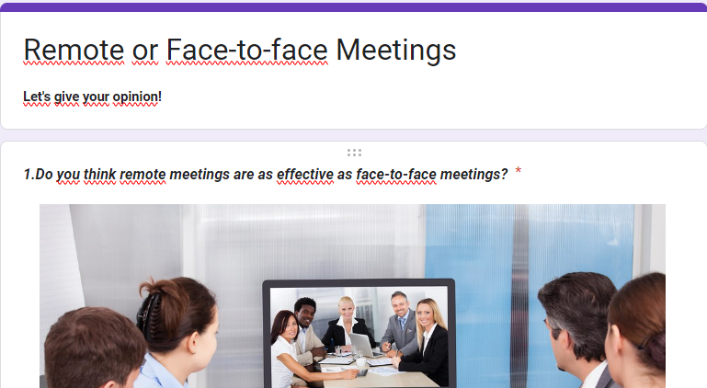
Give your opinion
Answer the following Survey.
https://forms.gle/KKPS5D7AN9s7hZKdA
Notes:
Answers to the comprehension questions:
1. Bob's main concern regarding robots and automation is that they will take over jobs, leading to unemployment and potentially causing societal upheaval.
2. The speaker counters Bob's concerns by pointing out that technological advancements have historically led to increased efficiency and prosperity, and that humans have adapted to these changes by learning new skills.
3. The speaker uses the example of the Industrial Revolution to illustrate the impact of technological advancements on employment, highlighting how automation has led to fewer people working fewer hours to achieve greater prosperity.
4. Some benefits of automation mentioned in the text include increased efficiency, reduced workload, and the ability to perform tasks that are difficult, dirty, dangerous, or time-consuming.
5. The speaker suggests that humans adapt to technological advancements by learning new skills and finding new opportunities, ultimately benefiting from having their previous jobs done by machines.

Slide 6
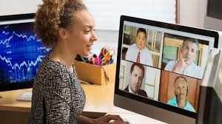
Video Conferences
Answer the pre-listening questions.
What common connection problems do you think you can have in a video conference?
In your opinion, what are the do’s or don'ts of video conferencing?
Have you ever joined a video conference from your bed?
https://www.youtube.com/watch?v=JMOOG7rWTPg&ab_channel=TrippandTyler
Notes:
Video: https://www.youtube.com/watch?v=JMOOG7rWTPg&ab_channel=TrippandTyler

Slide 7

Video Conferences
Answer Video activity.
https://en.islcollective.com/english-esl-video-lessons/a-video-conference-call-in-real-life/283635
Notes:
Video: https://www.youtube.com/watch?v=JMOOG7rWTPg&ab_channel=TrippandTyler

Slide 8
Discuss
Answer the following questions.
Name two problems (2) people had during the meeting.
Which of these connection issues do you usually have and how do you solve them?
What is the appropriate dress code for online meetings?
Have you ever said something unprofessional while you were unmuted?
Notes:
Answers to the comprehension questions:
1. Bob's main concern regarding robots and automation is that they will take over jobs, leading to unemployment and potentially causing societal upheaval.
2. The speaker counters Bob's concerns by pointing out that technological advancements have historically led to increased efficiency and prosperity, and that humans have adapted to these changes by learning new skills.
3. The speaker uses the example of the Industrial Revolution to illustrate the impact of technological advancements on employment, highlighting how automation has led to fewer people working fewer hours to achieve greater prosperity.
4. Some benefits of automation mentioned in the text include increased efficiency, reduced workload, and the ability to perform tasks that are difficult, dirty, dangerous, or time-consuming.
5. The speaker suggests that humans adapt to technological advancements by learning new skills and finding new opportunities, ultimately benefiting from having their previous jobs done by machines.

Slide 9
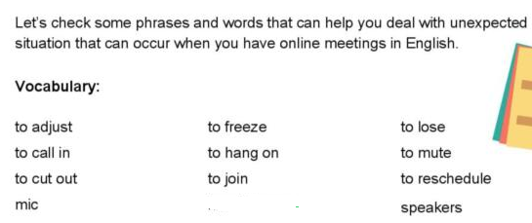
Useful vocabulary

Slide 10
Reading
Read the article “Daily Meetings”.
List down new vocabulary for you: (5 words, their meaning and examples).

Slide 11
DAILY MEETINGS PART 1
Mastering Virtual Meetings in the world of IT
A virtual meeting is a business meeting that’s held virtually, where the meeting participants aren't in the same physical room, but are instead meeting together at the same time from different locations through the use of technology. Depending on the needs of the meeting participants, virtual meetings can be set up with audio only or with audio and video for a more interactive experience.

Slide 12
DAILY MEETINGS
With virtual meetings, employees can keep up with work projects without jeopardizing the health of their coworkers.
Companies minimize travel costs and downtime
With in-person meetings, key stakeholders from different geographic locations must pay for travel arrangements and lose valuable work time traveling to different cities. Fortunately, anyone from your company can attend a virtual meeting with just a few mouse clicks.
Here are the primary advantages of virtual meetings:
Virtual meetings, especially those with video, are increasingly preferred by employees as a primary means of communication. Virtual meetings are shown to improve engagement and connection between employees, increase flexibility in the workday, and maximize productivity. In addition, companies that incorporate virtual meetings benefit in the following ways:
Employees with illnesses stay out of the office
Employees may feel the need to return to work before they fully recover from an illness, which can put other employees at risk.

Slide 13
DAILY MEETINGS
Employees feel connected and included
Working remotely can leave employees feeling disconnected from their work team and overlooked by managers. Virtual meetings can help reconnect your team and give employees an opportunity to collaborate on work projects.
Technology becomes familiar
When working in different offices or conference rooms, you may be working with different computers, conference systems, or devices in each location. Since employees generally use their own equipment for virtual meetings, the technology becomes more familiar for everyone on your team, allowing you to minimize downtime due to technical issues.

Slide 14
Vocabulary Activity
After reading the text look for new word and fill in the chart with their meaning and one(1) example.
WORD- MEANING | EXAMPLE
REMOTE: distant in time, relationship, connection, etc | More companies adopt remote work policies.

Slide 15
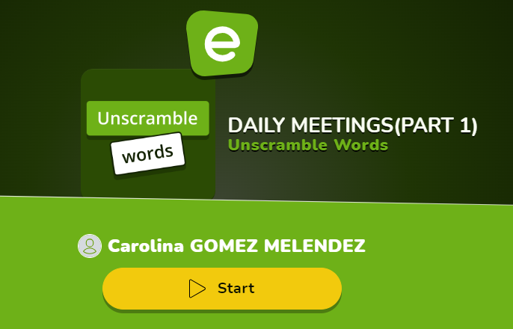
ACTIVITY # 1
https://es.educaplay.com/recursos-educativos/18526914-daily_meetings_part_1.html

Slide 16
DAILY ONLINE MEETINGS PART 2
Common Mistakes in daily meetings and How to Avoid them
Effective meetings are essential, but they often fall victim to a few common mistakes.
Excessive Meeting Length
To avoid lengthy meetings, limit the meeting time to 15 minutes and focus on updates that directly affect the team. Address complex issues in separate sessions
2. Lack of Team Engagement
Maximize engagement by interchanging the role of the presenter and asking open-ended questions. Mark all inputs and encourage active dialog to keep the team engaged.
3. Lack of Clear Purpose or Structure
Make sure each meeting has a clear purpose and follows a structured format, such as discussing yesterday’s accomplishments, today’s goals, and current obstacles. This approach keeps you focused and increases productivity.

Slide 17
DAILY ONLINE MEETINGS
5. Use reliable and easy-to-use Tools and Technologies
The right tools can bridge the gap between time zones and physical distances. Video conferencing platforms such as TrueConf, Zoom, or Microsoft Teams allow face-to-face communication, which increases team collaboration. These platforms have some Interactive features such as screen sharing or digital whiteboards that can replicate the collaborative atmosphere of in-person meetings, making remote stand-ups more interesting.
Best Practices for Participation:
To make the most of daily meetings in IT, consider the following best practices:
1. Be Concise: Keep updates brief and relevant to avoid prolonging the meeting unnecessarily.
2. Actively Listen: Pay attention to others' updates and offer assistance or insights where possible.
3. Be Proactive: If you encounter roadblocks, communicate them early and propose potential solutions.
4. Stay Engaged: Even if a topic doesn't directly relate to your responsibilities, remain engaged to foster a collaborative environment.

Slide 18
DAILY ONLINE MEETINGS PART 2
It is important to avoid technical difficulties that can disrupt the flow of information.
In conclusion, online meetings encourage open communication, enable problem-solving, and align team efforts toward common goals, thus driving projects to successful completion.

Slide 19
Vocabulary Activity
Go to the dictionary and look for a synonym for each one of the following words:
WORD | SYNONYM
REMOTE | DISTANT
mistakes
Address
Engagement
Purpose
Brief
Insights
Reliable
Disrupt

Slide 20
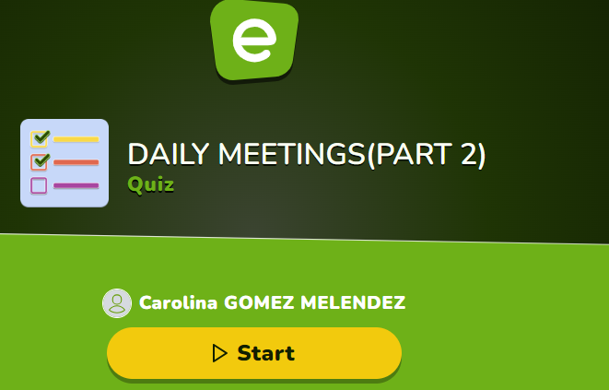
Activity # 2
https://es.educaplay.com/recursos-educativos/18527438-daily_meetings_part_2.html

Slide 21
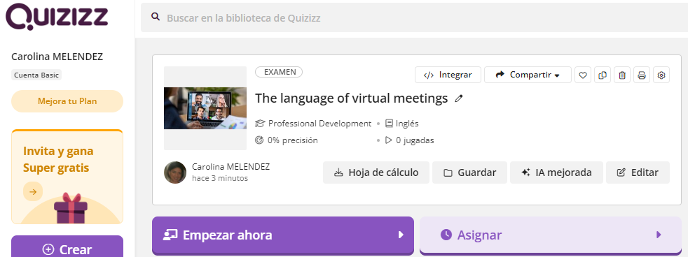
Activity # 3
https://quizizz.com/admin/quiz/663d4bcf1d1c6e16b1d28c02?searchLocale=

Slide 22
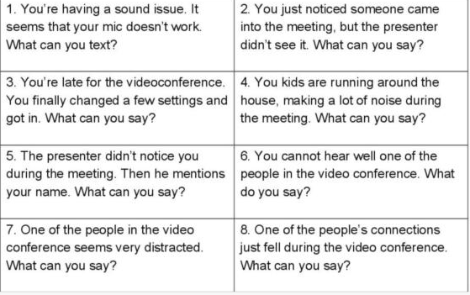
Homework #5
What would you say / react /do in these situations? Write your answers and upload them to your folder.

Slide 23


Slide 24
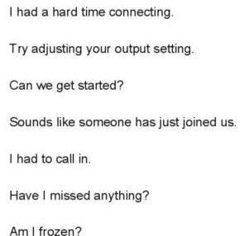
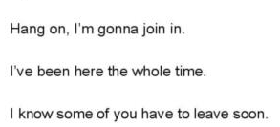

Useful expressions

Slide 25
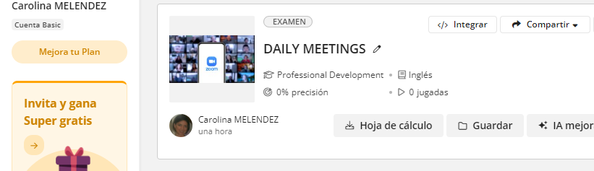
Activity # 3
https://quizizz.com/admin/quiz/660dc8ed7758bd116d28b5ea?at=660dcd93c2fc24965408559c

